Slide 1



Resilience & Healing for the Helper
Mindful Responses to Ego Depletion

Slide 2
Resilience & Healing
Resilience: A natural property of people
  “Ordinary Magic”
Resilience is the norm, not the exception
  Most people:
    “See the Silver Lining”
    “Discover what really matters”
    “Uncover hidden strengths”
  Most cities:
    “Cooperate and Bond”

Slide 3
Resilience
Resilience = Successful Adaptation to Adversity
  A quality that people have to one extent or another (i.e. Resilient People)
Two Factor Model of Resilience
  Recovery (How well people bounce back and recover from challenge; i.e. loss of equilibrium regained equilibrium)
  Sustainability (Capacity of people to continue forward in the face of adversity; i.e. not lose equilibrium)

Slide 4
Resilience in Two Factors
Recovery from Current Adversity:
  You Lose Equilibrium
  Go through a process of recovery (exercise resilience)
  Return to Equilibrium (and previous level of Sustainability)
Sustained Individual Resilience:
  The amount of stress that a person can endure without a fundamental change in capacity to pursue aims that give life meaning
  Sustainability = Preserving valuable engagements in life’s tasks at work, play, and in social relations

Slide 5
Loss of Equilibrium
You can only exercise Resilience skills if you are AWARE that you’ve lost Equilibrium (or are in danger of losing Equilibrium)
Loss of Equilibrium, in the Context of “Work,” is called “Burnout”
  Long term exhaustion and diminished interest in work
Burnout is caused by being in a consistent state of Ego Depletion

Slide 6

System Overload
Task Demands
Distractions
Noise
What else causes
overload to you?

Slide 7

Have you ever felt stuck?
Too many decisions
Too many demands
HALT
  Hungry
  Angry
  Lonely
  Tired

Slide 8
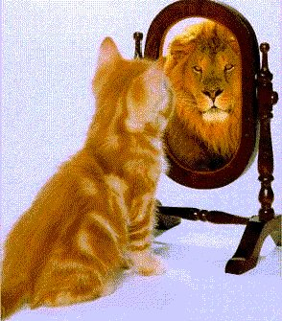
You’ve been EGO DEPLETED!
Ego: The capacity to be self aware
  Aware of external events
    Environmental Demands
  Aware of internal events
    Feelings, Emotions, Thoughts,
      and Sensations
  Able to Self-Regulate Responses
    Affective, Behavioral, Cognitive

Slide 9
You’ve been EGO DEPLETED!
Self-Regulation is “WILLPOWER”
  Willpower: The ability to alter Affect, Behavior, Cognition
Willpower is a FINITE RESOURCE
It can be DEPLETED

Slide 10
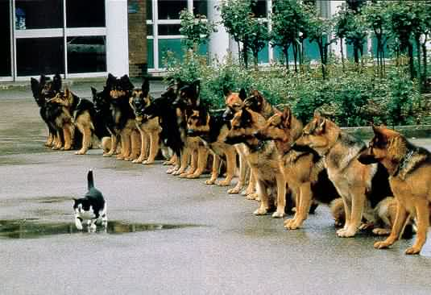
THIS is what Will Power looks like!

Slide 11
Ego Depletion
Effort
  It just feels harder to do anything
Perceived Difficulty
  And everything looks harder to do
Negative Affect
  And you feel angry, sad, ashamed, afraid too easily
Subjective Fatigue
  Tired, no energy left in your body
Blood Glucose Levels
  Are depressed in this mind-state, especially brain blood-glucose

Slide 12
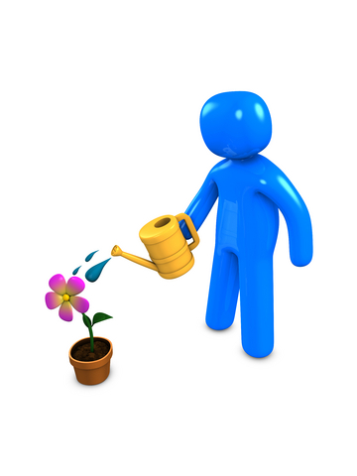
Ego Replenishment
Catch the Slide!
  Practice Mindfulness
  Cultivate Acceptance
  Develop Skillful Means

Slide 13

Mindfulness
The capacity to be fully present
  Noticing
  Non-Judgmentally
  With Authenticity

Slide 14
Mindfulness & Acceptance
The awareness that emerges through paying attention on purpose, in the present moment, and non-judgmentally to the unfolding of experience moment to moment (Kabat-Zinn, 2003)
Non-judgmental observation of the ongoing stream of internal and external stimuli as they arise (Baer, 2003)
Acceptance = Non-Evaluative Awareness

Slide 15
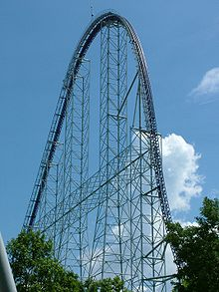
Focused Attention Exercise
Notice!!
  Watch this video Mindfully
http://www.youtube.com/watch?v=FXaJgsMAuGI

Slide 16

Focused Attention Exercise
What happened in your body?
  Sensations?
  Emotions?
  Thoughts?
  Behaviors?
Did you feel overloaded?

Slide 17
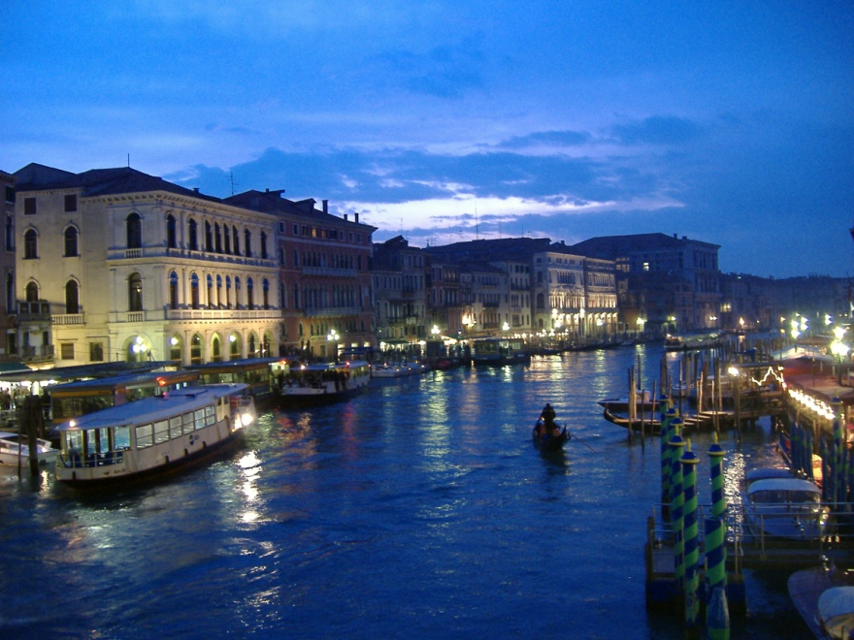
Ego Restoration
Skillful Means
Know the Antidotes
  Rest
    Sleep Restores!
  Nutrition
    Glucose Replenishment
  Positive Affect
    Laughter IS the best medicine!
  Exercise
    Balance Rest With Aerobic Exertion

Slide 18
Building Ego Resilience
How do you build up the “muscle” of ego strength?
  Give something up
  Choose tasks that require persistence
  Establish structure and routine in your life

Slide 19
Surviving Stress
Mindful Responses to Ego Depletion
It’s a hard life sometimes!
Learn to be mindful of your mind/body
Accept when you’re overwhelmed
Know the Antidotes
Establish a Practice

Slide 20
A Few Final Words…
The Guest House, by Rumi
  Radical Acceptance of Life on Life’s Terms
3 Simple Rules to Live By
  Bad Things Happen
  Nothing is Permanent
  It’s Not About YOU Anyway!
James M. Walsh, PhD, LPCMH
walshjm54@yahoo.com

